Slide 1
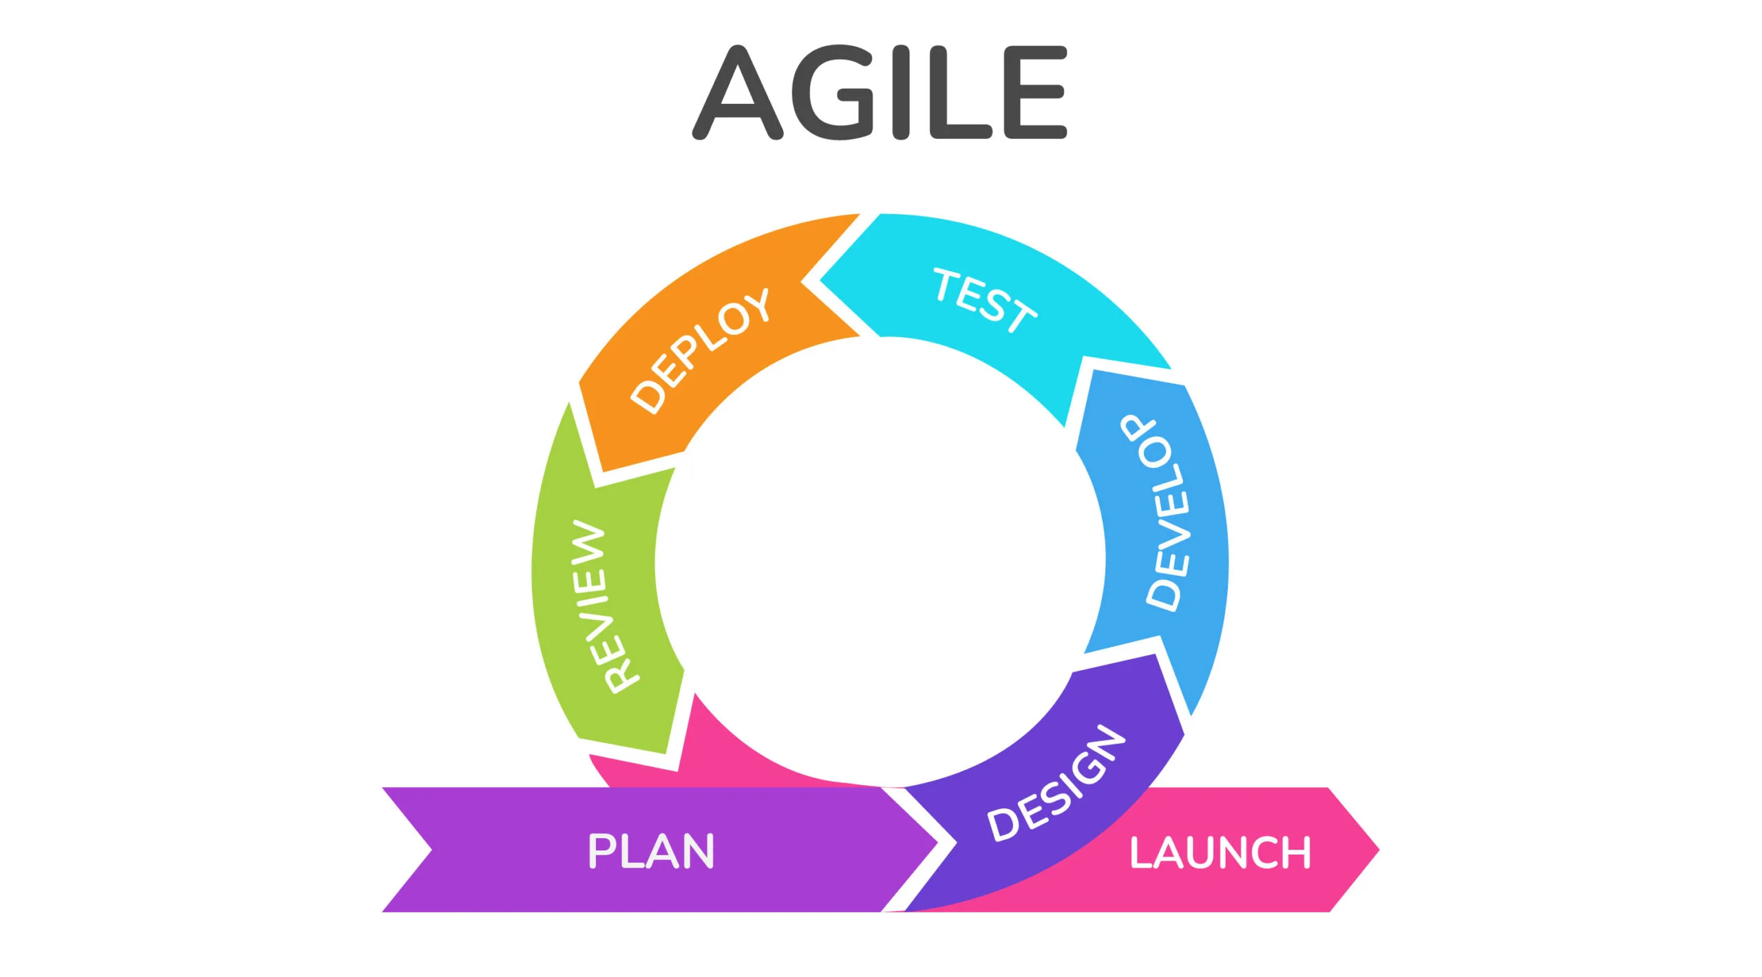
Agile Presentation
By: Karina Washington

Slide 2
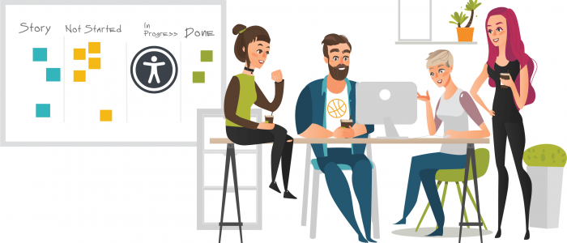
Roles on a Scrum-agile Team
1.Scrum Master 2.Product Owner 3.Development Team 4.Tester
5.Stakeholders 6.User

Slide 3
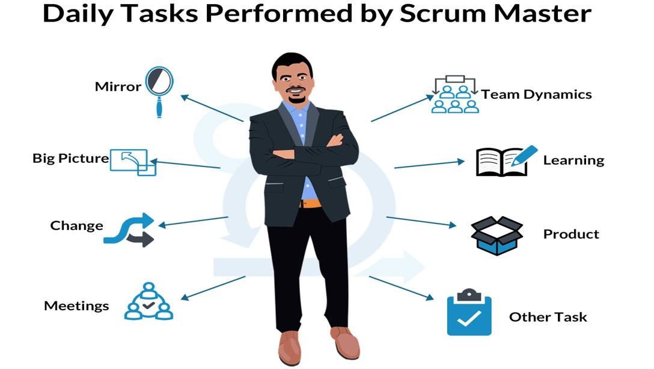
Scrum Master:
Scrum masters often coach new teams on agile processes, responsibilities, and tools. Scrum master responsibilities can include resolving blocks that impede progress, reviewing approaches to improve the agile team’s velocity, and grooming backlogs.

Slide 4
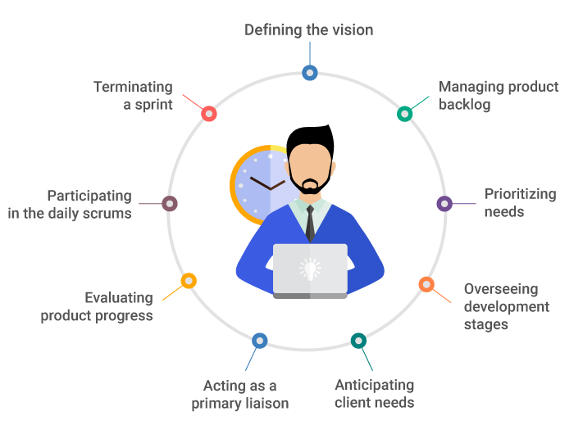
Product owner
The product owner is tasked to be the voice of the customer, including any internal stakeholders. This person distills insights, ideas, and feedback to create a product vision. Product visions are often short and straightforward, but they nonetheless paint a picture of who the customer or user is, what values are being addressed, and a strategy for addressing them.

Slide 5
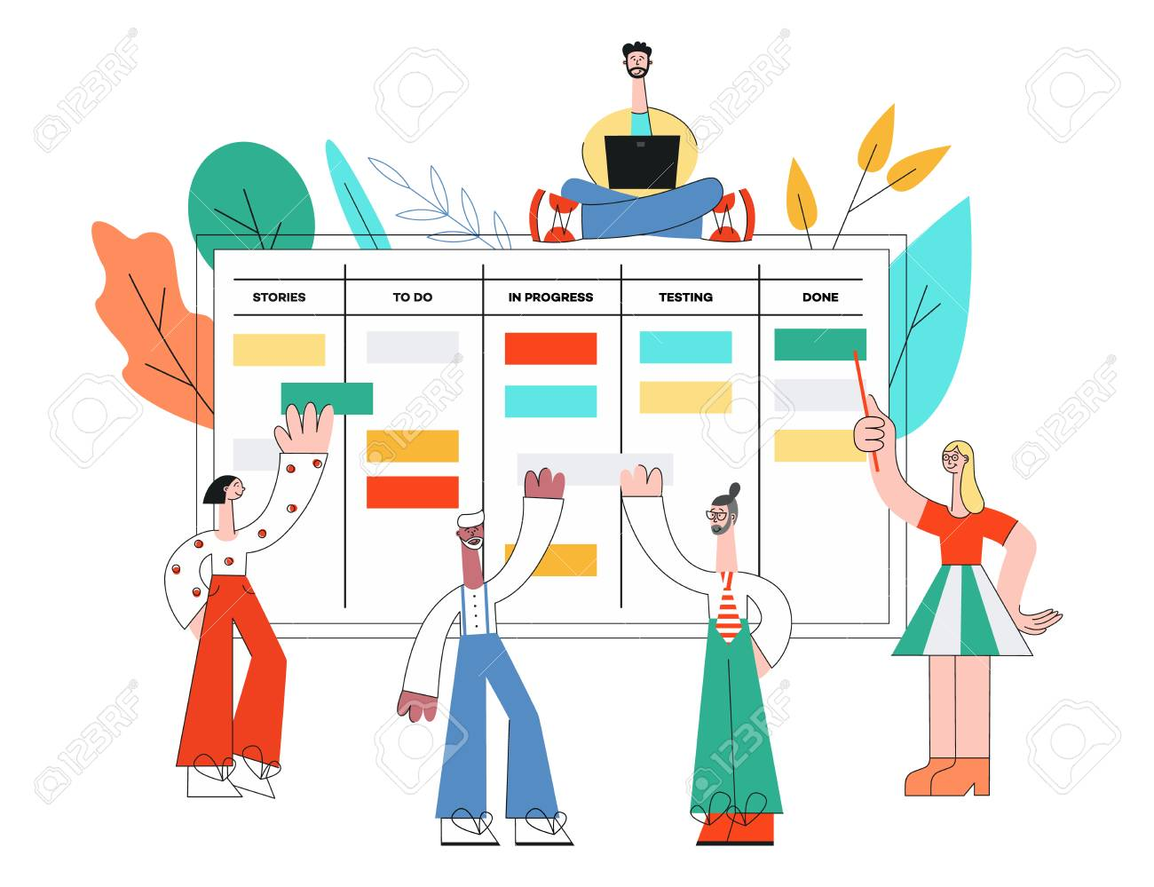
Development Team:
The Development Team is responsible for designing, developing, and testing the product. It's a self-organizing and cross-functional group that collaborates to deliver increments of the product during each sprint. Team members bring a variety of skills and expertise to the table, and they collectively own the commitment to delivering high-quality increments.

Slide 6
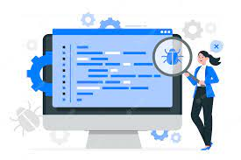
Tester:
Testers play a critical role in ensuring the product's quality by identifying and preventing defects. They work closely with the development team and the Product Owner to understand user stories and acceptance criteria. Testers create and execute test cases, perform regression testing, and contribute to delivering a shippable product increment at the end of each sprint.

Slide 7

Stakeholders
While not a formal role within the Scrum team, stakeholders represent anyone with an interest in the project's outcome. They provide feedback, prioritize features, and help shape the product. Regular collaboration with stakeholders is essential to ensure that the product aligns with business goals and user needs.

Slide 8

User
The user role represents the end-users or customers who will eventually use the product. Their feedback and input are crucial for shaping the product's features and functionality. Continuous engagement with users helps ensure that the product meets their expectations and solves their real-world problems.

Slide 9
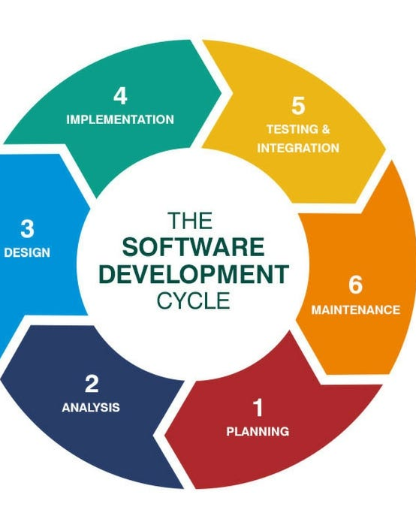
SDLC
Agile SDLC model is a combination of iterative and incremental process models with focus on process adaptability and customer satisfaction by rapid delivery of working software product. Agile Methods break the product into small incremental builds. These builds are provided in iterations. Each iteration typically lasts from about one to three weeks. Every iteration involves cross functional teams working simultaneously on various areas like −
Planning
Requirements Analysis
Design
Coding
Unit Testing and
Acceptance Testing

Slide 10
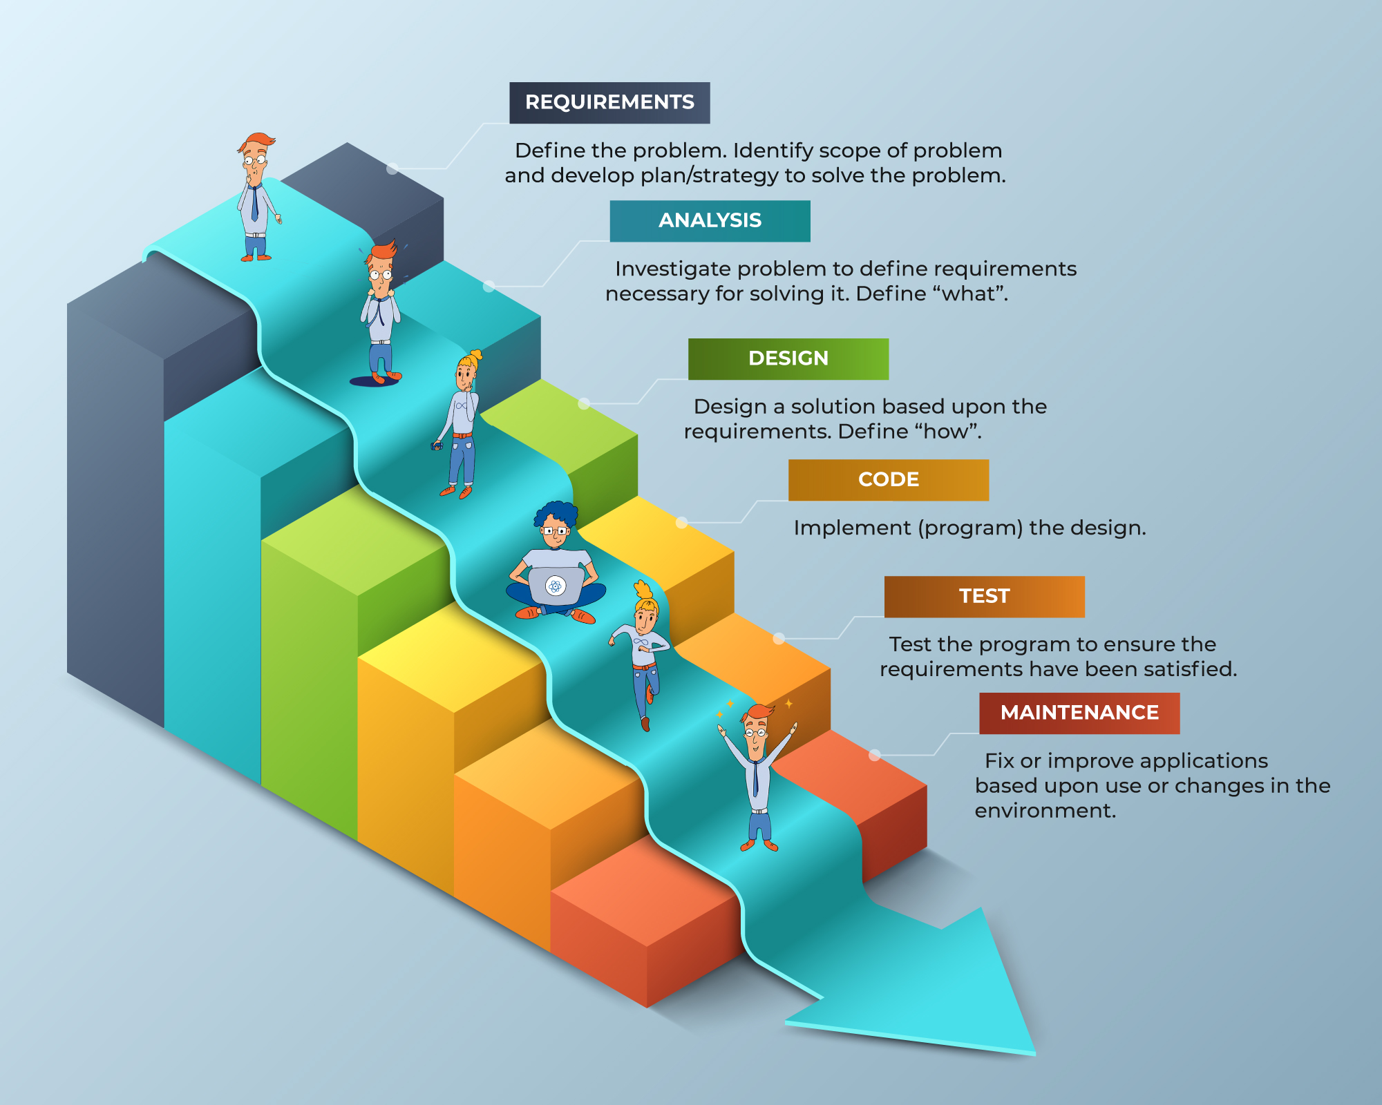
Waterfall

Slide 11

The process with Waterfall vs Agile
Requirements. During this phase, you outline the big picture of your project’s requirements. These are, “high-level statements that could be implemented in many different ways,” according to Dr. Chris Mattmann, Chief Technology and Innovation Officer (CTIO) at NASA Jet Propulsion Laboratory. For example, a requirement could be that a B2B software process a million transactions per day, or serve a community of 10,000 concurrent users.
Example for the SNHU travel project: In the waterfall approach, the first phase involves gathering all the project requirements upfront. For the SNHU Travel website, this would include gathering detailed specifications for features, design elements, user interactions, and any other project requirements. This phase would involve extensive communication with stakeholders, including the client, marketing team, and other relevant parties. Once all the requirements are documented and approved, the development team moves to the next phase.

Slide 12
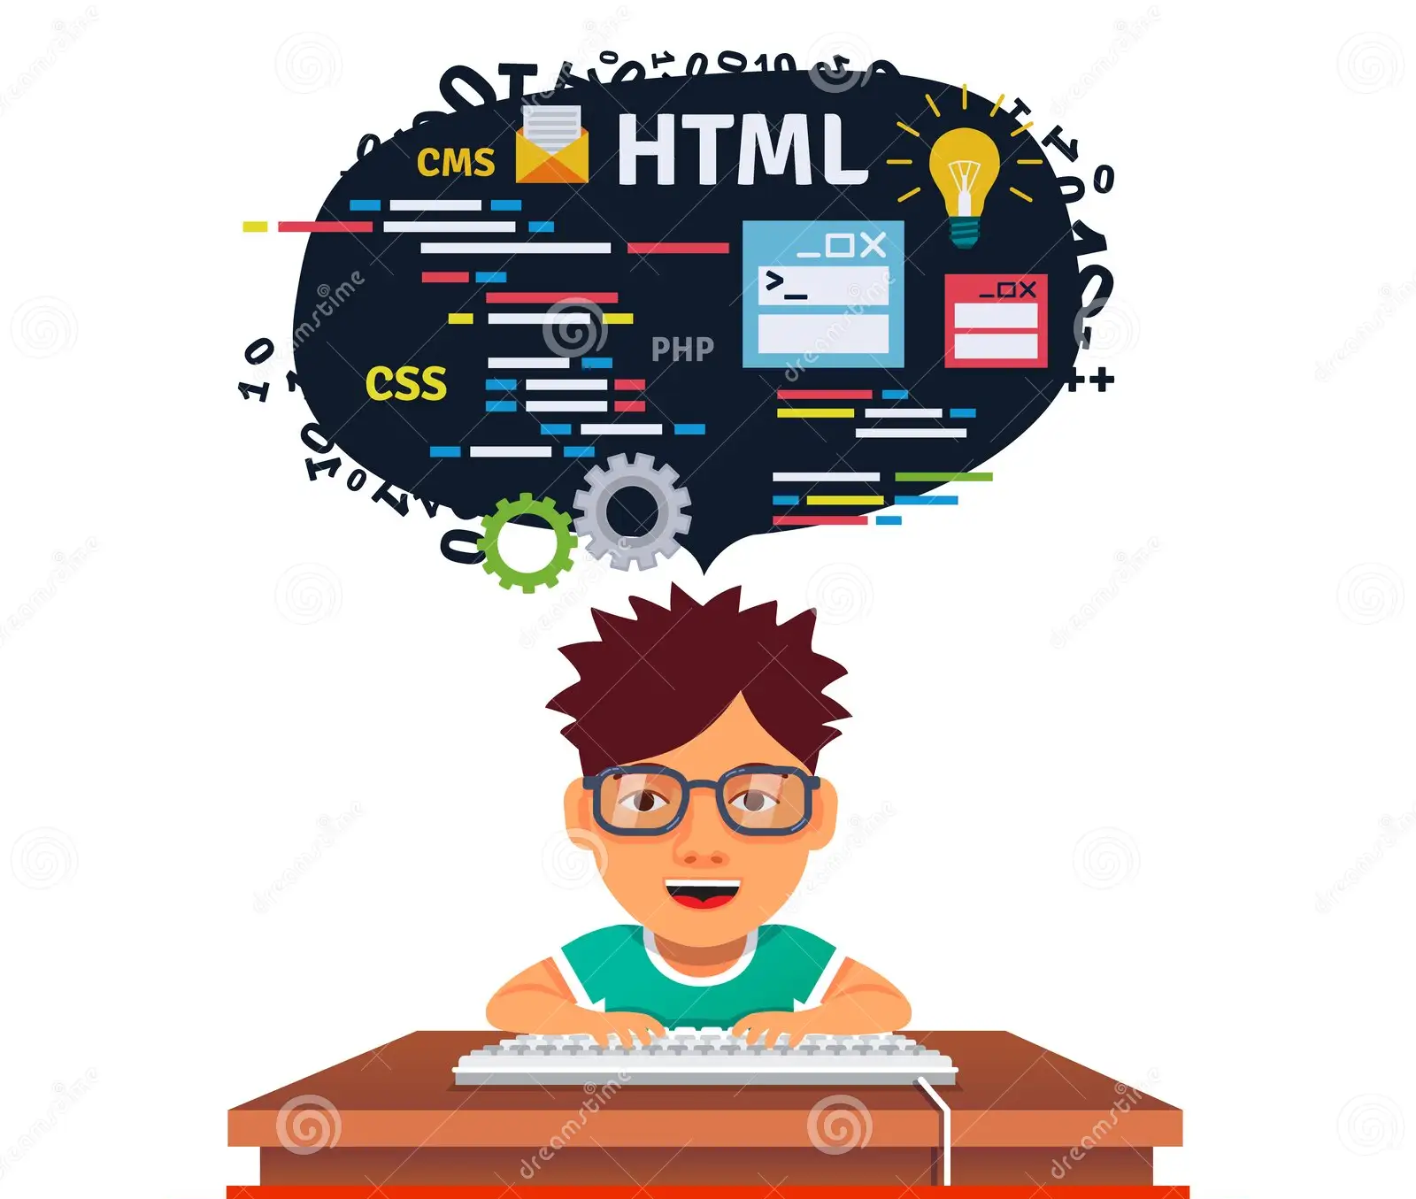
Design.
Design. Once you understand the project requirements, the next step is to come up with ways to design solutions that meet them. For example, if the requirement is processing one million users per day, you’d consider possibilities that will best support this during the design phase. As Mattmann explained, “We probably shouldn’t have a single backend server because that’s not resilient. So maybe our design says we should have redundancy with multiple backend servers so that if one goes, we can still meet that goal of processing a million transactions a day.”
Example for the SNHU travel website: During the system design phase, the architecture and design of the entire website are planned in detail. This includes designing the user interface, creating wireframes and mockups, defining the database structure, and outlining the overall site structure. Designers, UX experts, and architects collaborate to create a comprehensive design that aligns with the gathered requirements.

Slide 13
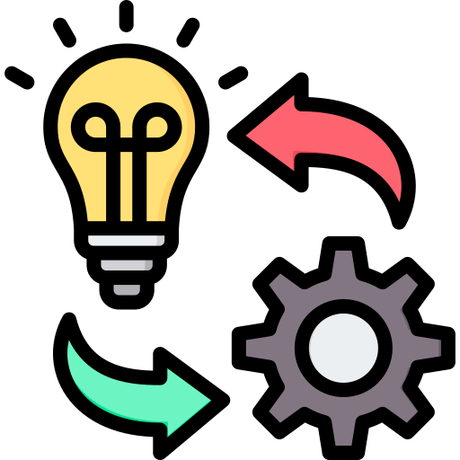
Implementation
Implementation. During this phase, you select one of your candidate designs and use technology to implement them. This could involve collecting data and inspecting whether the design is able to support the requirements.
Example for SNHU travel website (Coding): With the design in place, developers start coding the website based on the approved design documents. This phase involves translating the design into actual code, developing frontend and backend components, and integrating third-party tools if needed. Each development task is completed before moving on to the next one. For instance, the homepage might be developed and tested before moving to other sections.

Slide 14
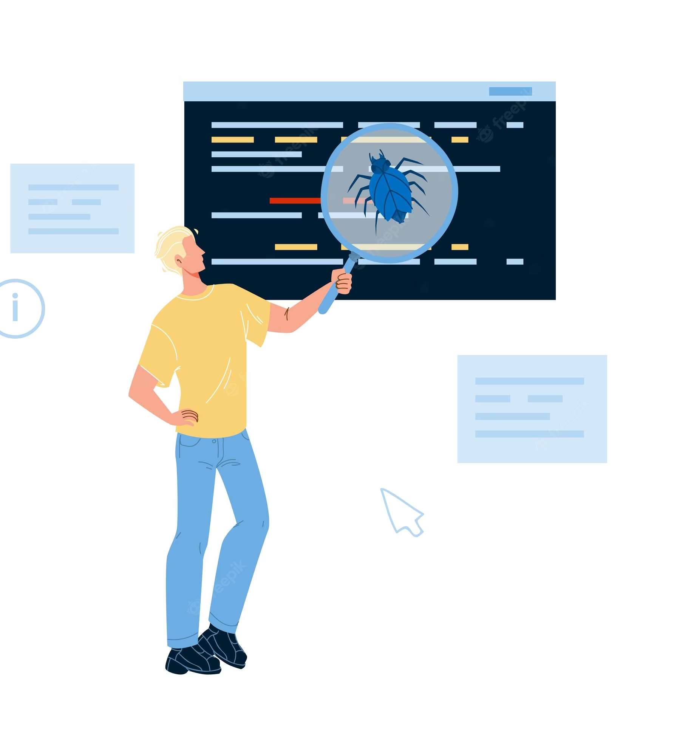
Test
Verification/ Test . During this phase, you take the implementation you created in phase four and test whether it validates your requirements. If, for example, the original requirement was to process one million transactions per day, you would test whether this is possible. If you run into issues—say you can only run 500,000 transactions per day—here’s where you would go back and test where issues could have come up, Mattmann explained.
Example for SNHU travel website. Integration and Testing: Once development is complete, the website components are integrated into a unified system. This phase involves rigorous testing to identify and resolve any bugs, errors, or inconsistencies. Testing includes functional testing, performance testing, compatibility testing, and security testing. Testers validate that the website functions as expected and meets the predefined requirements.

Slide 15
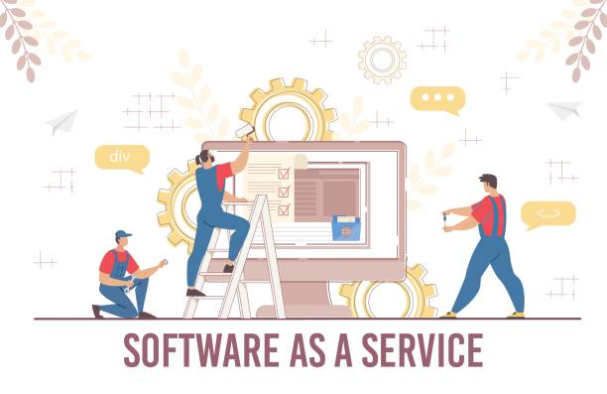
Maintenance
Maintenance. The project isn’t over once it has gone through validation and verification. The system still needs to be maintained. During maintenance, you are “designing strategies for updating and upgrading,” Mattmann said. This involves patching systems, upgrading the systems, implementing a software upgrade or testing for errors and fixing them if they do occur.
Example for SNHU travel website : Once the website is live, ongoing maintenance and support are required to address any issues that may arise post-launch. This could include bug fixes, updates, enhancements, and ongoing monitoring to ensure the website's optimal performance and reliability.

Slide 16
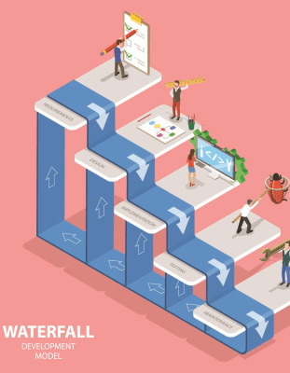
Factors to consider to choose Waterfall
When deciding between a waterfall approach and an agile approach for a software development project, several factors need to be considered. The choice between these methodologies depends on the nature of the project, its requirements, timeline, team dynamics, and the level of uncertainty involved. Based on my experience with the software development lifecycle course, I can provide insights into the factors that influence this decision.
In the context of the software development lifecycle course, we experienced aspects of both methodologies. While the course provided structured phases that mimicked the waterfall approach, it also emphasized iterative development and regular feedback, akin to agile principles. This exposure underscores the importance of selecting the right methodology based on project specifics.
Ultimately, the choice between waterfall and agile should align with the project's nature and objectives. While waterfall offers predictability and structure, agile provides flexibility and adaptability. The course's blended approach highlights that certain projects may benefit from a mix of both methodologies to strike the right balance between planning and flexibility.

Slide 17
References
Aydar. A.(2021, May, 17). SDLC Agile Model. Tutorialspoint.
https://www.tutorialspoint.com/sdlc/sdlc_agile_model.htm
Sacolick. I. (2022, April, 6). What is agile methodology? Modern software
development explained. InfoWorld.
https://www.infoworld.com/article/3237508/what-is-agile-
methodology-modern-software-development-explained.html
Watts. R. (2020, March, 22). What Is Waterfall Methodology? Here’s How It Can Help Your Project Management Strategy. Forbes Advisor.
https://www.forbes.com/advisor/business/what-is-waterfall-methodology/

